Slide 1
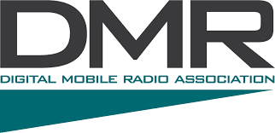
Intro to DMR
Presented by: Tim Watson, KB1HNZ

Slide 2
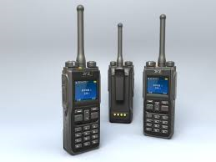
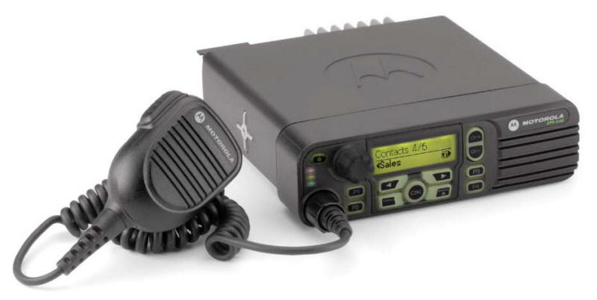
DMR, or Digital Mobile Radio, is an Open Standard defined by the European Telecommunications Standards Institute (ETSI), and used in commercial and amateur products around the world.

Slide 3
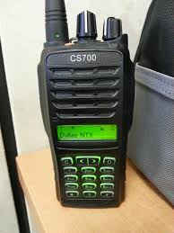
Designed to operate within the existing 12.5 kHz channel spacing used in licensed land mobile frequency bands globally AND to meet future regulatory requirements for 6.25 kHz channel equivalence.
Affordable digital systems with low complexity.
DMR products are sold in all regions of the world.
The DMR protocol covers:
Unlicensed (Tier I)
Licensed Conventional (Tier II)
Licensed Trunked (Tier II)

Slide 4
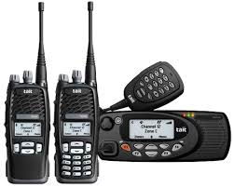
DMR, similar to P25 Phase II, both use two-slot TDMA (Time Division Multiple Access) in a 12.5 kHz channel, while NXDN uses discreet 6.25 kHz channels using frequency division.
The primary goal of the DMR standard is to specify a digital system with low complexity, low cost, and interoperability across brands, so radio communications end users are not locked into a proprietary solution.
This being said, there are brands which have not adhered to this open standard and have introduced proprietary features that make their products incompatible with some networks.

Slide 5
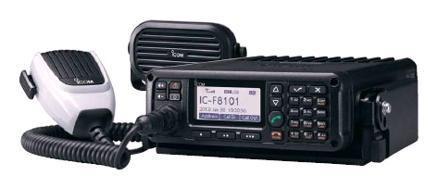
Open Interfaces, Open Standards, and an Open Philosophy.
In 2005, a Memorandum of Understanding was formed with potential DMR suppliers to establish common standards and interoperability. Although the standard does not specify it, members agreed to use the half-rate DVSI Advanced Multi-Band Excitation (AMBE) vocoder to ensure interoperability.
In 2009, members established the DMR Association to further advance the standard and to maintain interoperability.
Formal testing has been taking place since 2010.

Slide 6
DMR and Ham Radio
All-digital network of over 400 repeaters in 37 countries.
More than 10,000 registered users
Repeaters are connected ALL the time.
Excellent voice quality and extended battery life.
Less than 1/3 the channel bandwidth of analog FM with twice as many voice channels!
Reliable and scalable choice in connectivity

Slide 7
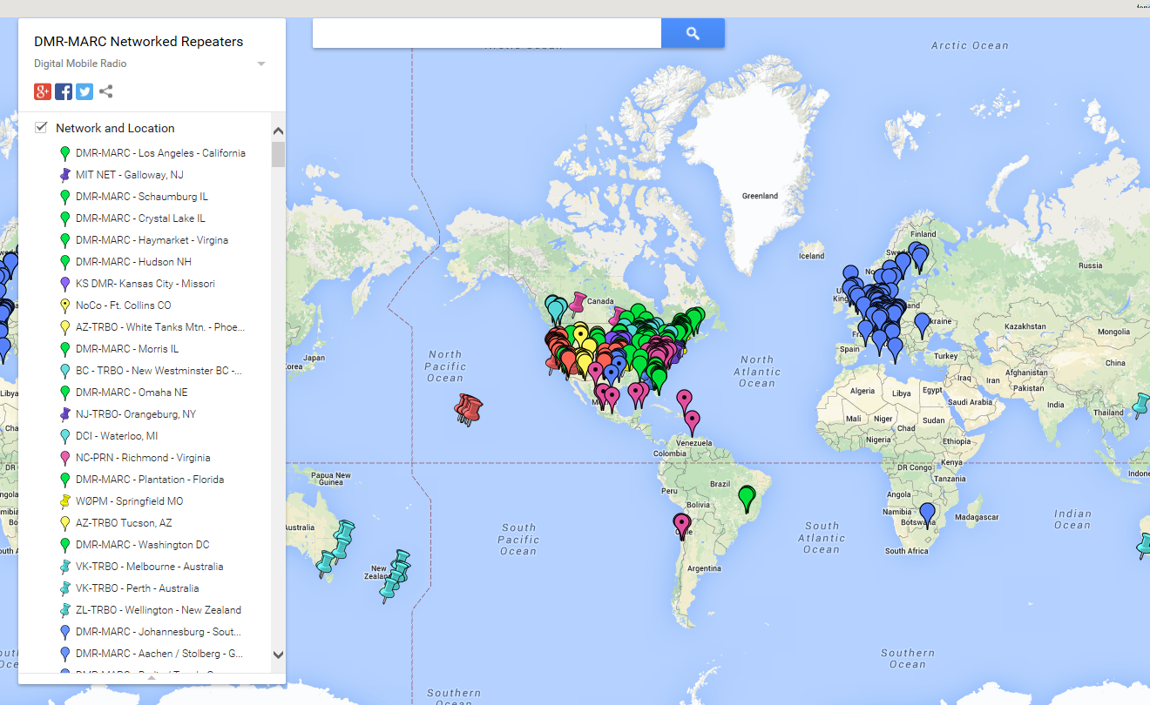

Slide 8
Source: DMR-MARC Newsletter - May, 2014

Slide 9
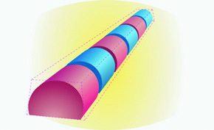
Two-Slot TDMA
DMR Tier II / Tier II occupies a 12.5 kHz bandwidth with tow channels sharing using Time-Division Multiple Access (TDMA). This results in spectrum efficiency of 6.25 kHz per channel.
Comparing spectrum efficiency of DMR to a wideband FM modulated signal, DMR only uses 25% of the bandwidth per talk channel. Each channel can carry either voice or data, depending on the system design. The two time slots are called Time Slot 1 (TS1) and Time Slot 2 (TS2).
Left: fc -12.5 fc fc+12.5 Wide-band FM 25 kHz Channel Bandwidth
Right: fc –6.25 fc fc +6.25 DMR 12.5 kHz Channel Bandwidth
For the amateur, this means one repeater allows two separate channels at the same time. Currently, most amateur DMR repeater systems utilize both channels for voice and some limited text messaging. Typically one channel (time slot) is used for wide-area and the second is local and regional talk groups.

Slide 10
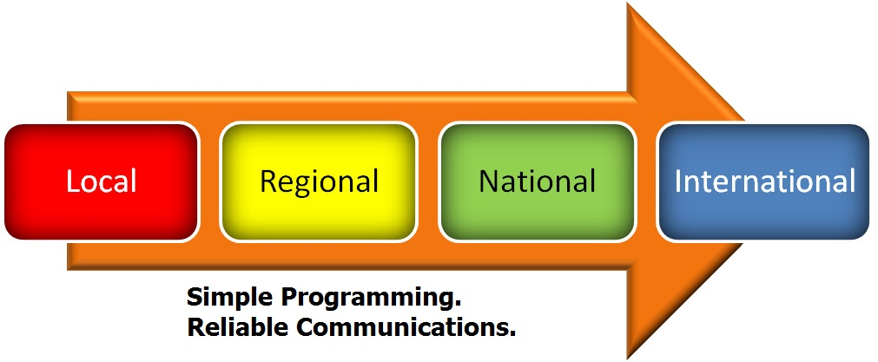
Scalable Connectivity – A Closer Look

Slide 11
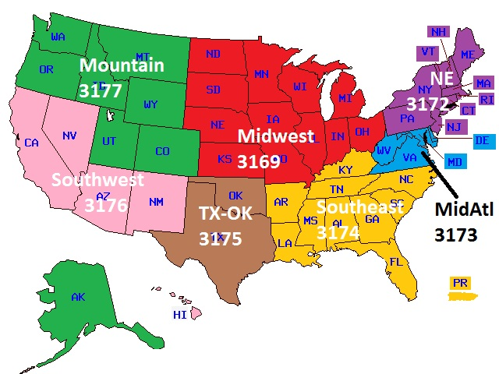
Regional Talk Groups
New England Talk Groups
(available on most NE repeaters)
Local 9 TS2
SNE 3109 TS2
NNE 3133 TS2
MA 3125 TS2
NE 3181 TS2
Northeast 3172 TS1
NA 3 TS1
WW English 13 TS1
WW Calling 1 TS1
TAC310 310 TS1
Bridge 3100 TS1
Audio Test 9999 TS1

Slide 12
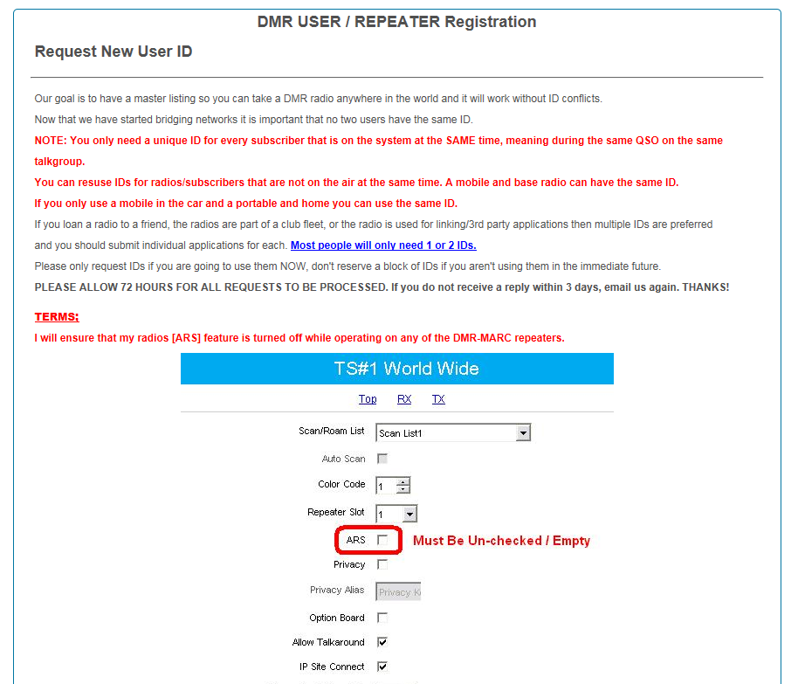
First Steps - Registration
Go to the DMR-MARC website and follow the on-screen instructions.
Although it says “User” registration, it is possible to have more than one ID, (but this is not recommended).
A mobile and a base station, for example, could have the same ID as long as they are not transmitting on the same Time Slot and Talk Group at the same time.
This is also where you would register a repeater on the DMR network.

Slide 13
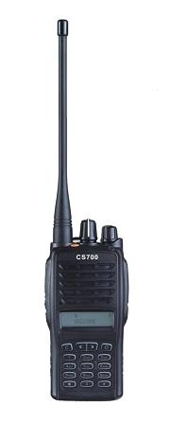
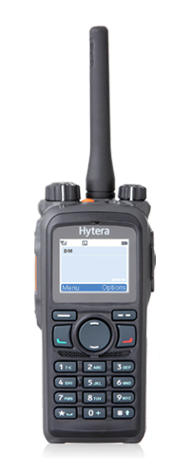
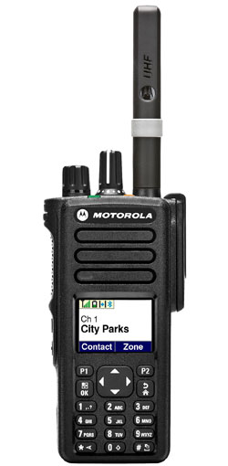
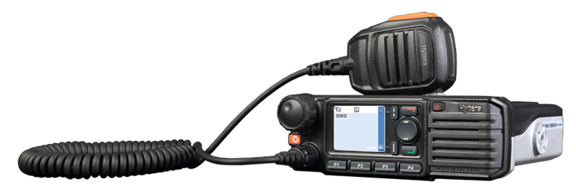
Get a radio!
Manufacturers include:
Hytera, Motorola, Kenwood, Vertex Standard, Icom, Connect Systems, and more!

Slide 14
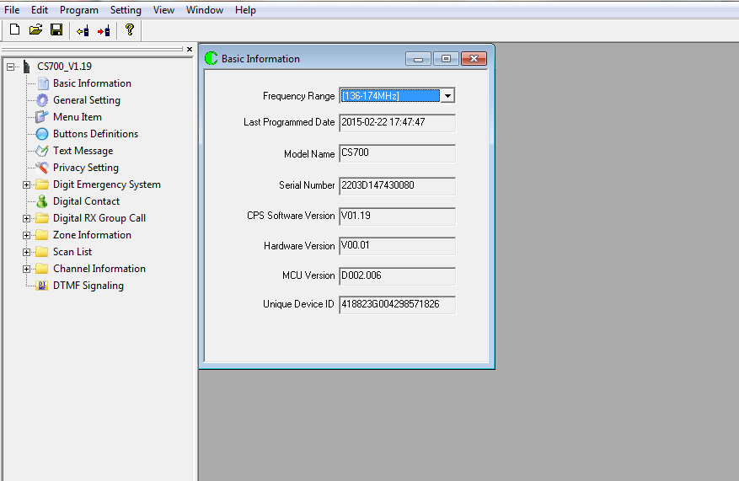
Radio Programming
Connect Systems CS701
Serial number, model info, and firmware data is auto filled on the initial read of the radio’s memory.

Slide 15
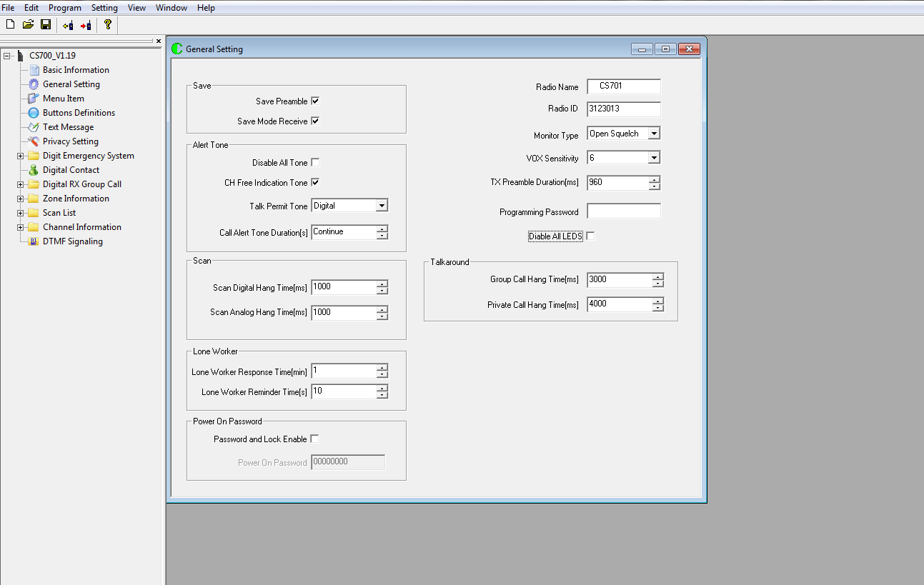
‘Radio ID’ is your registration number.

Slide 16
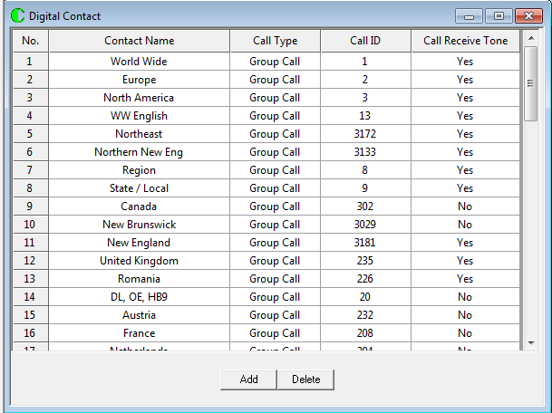
Digital Contact is where you associate a Call ID with a Display Name (Contact Name).
The Contact Name, on the left, will display when you transmit on one of these Call Groups.

Slide 17
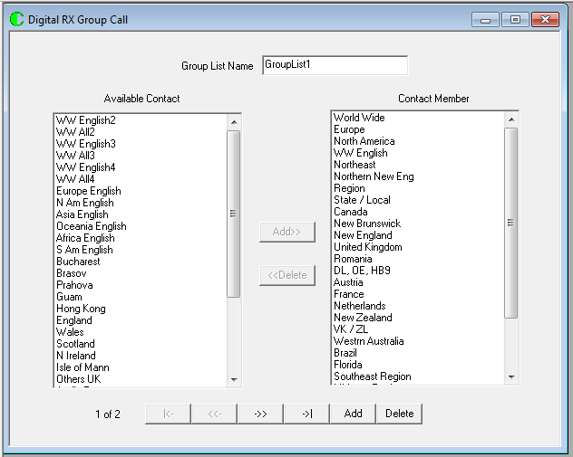
This is where you select what to receive when you program a channel. First, create the contacts, and then create Group Lists (Receive Groups) by moving them into the column on the right.

Slide 18
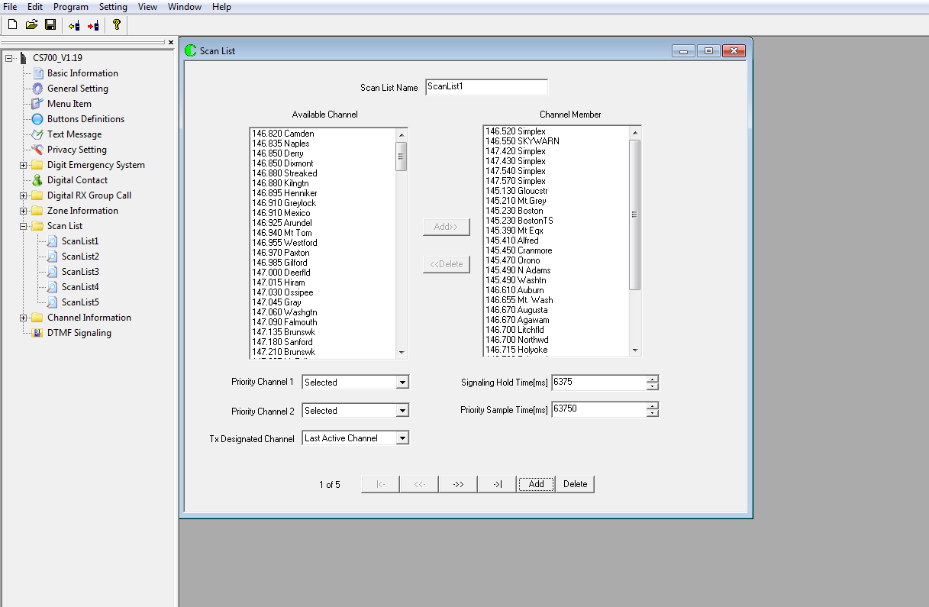
Scan Lists
Scan lists are created similarly to Group Call RX Lists.
Create a Scan List by selecting channels from the left column and moving them to the right.

Slide 19
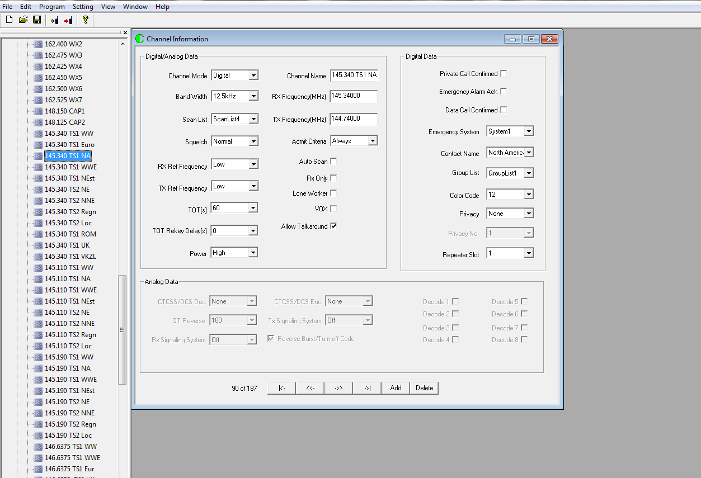
Channel Programming

Slide 20
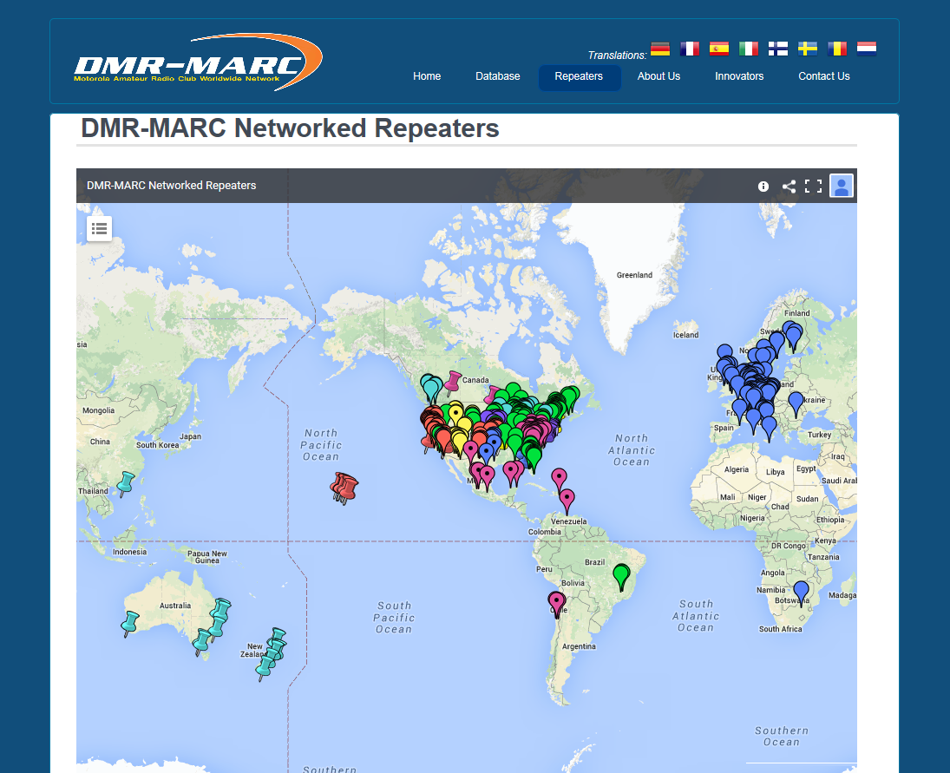
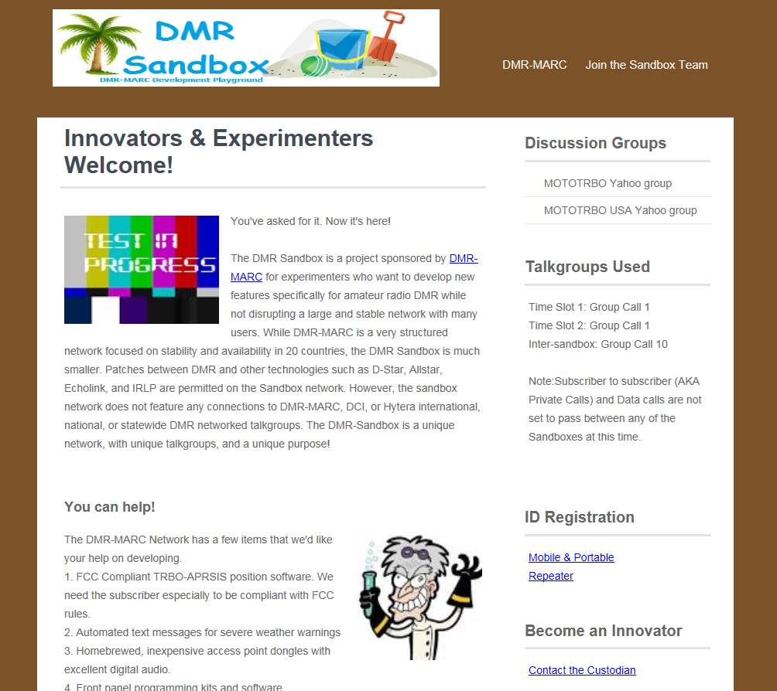
For more info, visit:
www.dmr-marc.net

Slide 21
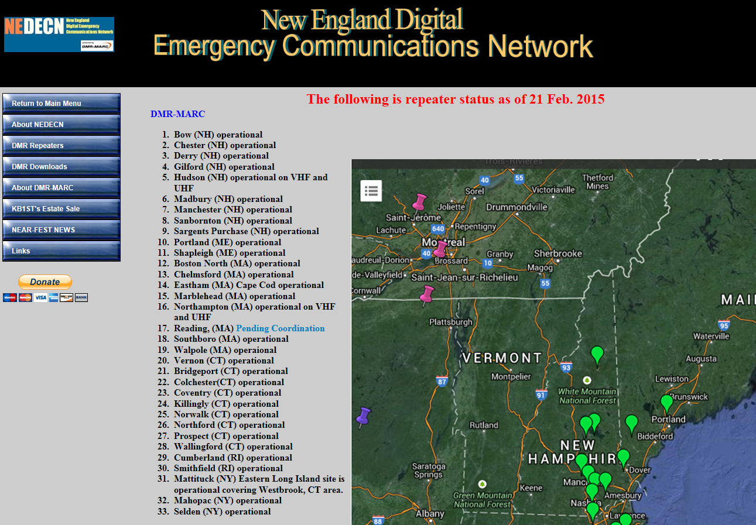
www.nedecn.org

Slide 22
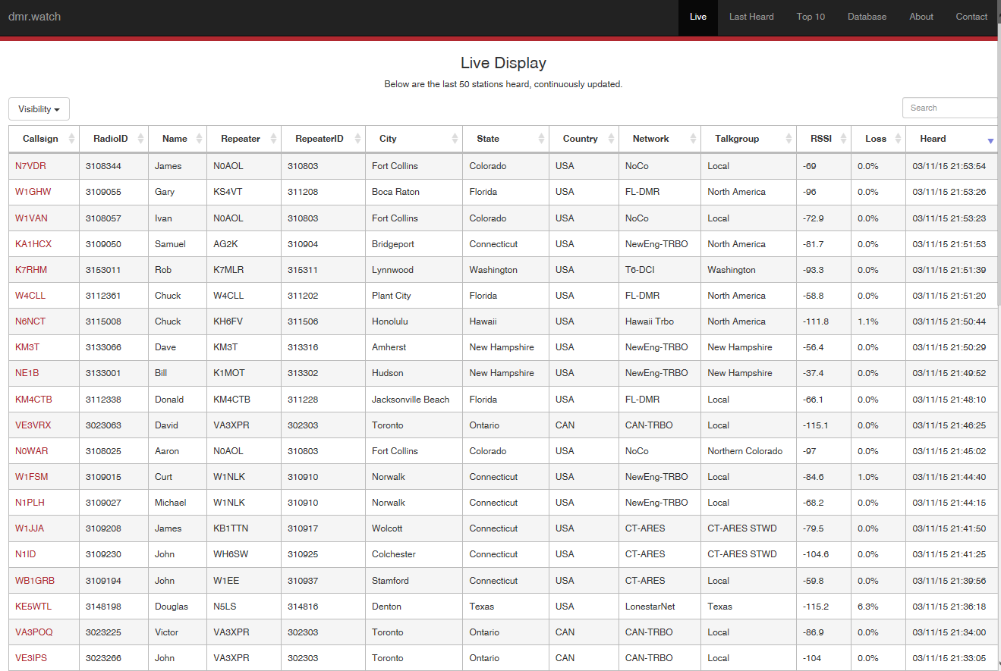
www.dmr.watch

Slide 23
Intro to DMR - Wireless Society of Southern Maine ©2015

